Slide 1

Growth Models
Harrod-Domar,
Solow, and Endogenous Growth Models
Copyright@Ashis Kumar Pradhan

Slide 2

Harrod-Domar Model vs Keynesian Model
Proposed by: Roy Harrod in 1939 and Evsey Domar in 1946.
Extension of the Keynesian model. However, the basic difference between Keynesian model was that it was a static model which emphasizes on aggregate demand and its effect on the output gap in the short-run. But Harrod-Domar Model focused upon investment-spending component of aggregate demand influencing the productive capacity in the long-run.
Keynesian Model- Demand Side
Harrod-Domar Model- Supply side

Slide 3
Harrod-Domar Model
According to this model, Growth rate of an economy is conditional upon saving.
More is the saving, more is the ability to invest, higher is the productivity level of capital, more is the growth.
Alternatively higher population growth and depreciation rate of machines will slow down the growth.
More population means, on average, people will save less and hence the ability to invest.
Similarly, more the depreciation of machines, lesser is the investible surplus available for future capital formation.
Therefore, economic growth will be possible by implementing policies pertaining to increase saving/investment and using the investment more efficiently through technological advancements.

Slide 4
Limitations of Harrod-Domar Growth Model
Harrod-Domar models assumes a strong relationship between growth and investment. However, India– a developing economy failed to grow faster because of poor capital productivity but not because of poor saving performance. Government invested lavishly in public sector units which were highly inefficient.
The model assumes labour and capital to be used in equal proportions. This may not be true for a labour abundant less developed nation or for capital abundant developed nations.
Over the years, irrespective of economies, the price of capital has fallen in comparison to the labour.

Slide 5
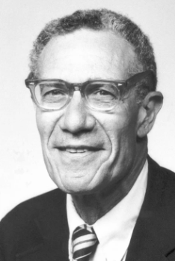
Solow Growth Model
Proposed By: Robert Solow in the February 1956 and Trevor swan also came up with same findings in December 1956.
Solow assumed a perfect factor market so that planned investment always equals to planned savings.
He explained a variation in the growth and per capita income across countries in terms of a simple production function Y= f(L, K).
Countries with greater supply of skilled labour and physical stock of capital would have greater per capita income. Other things remaining equal, an increase in per capita income could be brought through an increase in savings or by decrease in population growth, and depreciation rates in capital.
The model assumes that initially a country has abundant capital with less labour. So the per capita of a country grows at a rate with which population grows. However, this process of growth continue till the relative supply of capital equals that of labour.
Hence, in the long-run the economy achieves a steady state growth– a situation where in the economy continues to grow at the rate at which population grows.

Slide 6
Solow Growth Model
A country can not grow at the rate of growth of capital because it is the labourer who saves and savings lead to the creation of capital. Per capita income continues to grow until the labour saves and no investment takes place when the economy reaches steady state.
The model is more suitable to depict growth behaviour of developed economies with surplus capital.
The unexplained portion of growth, that is over and above what was explained by capital stock and labour, was attributed to technology, which is also reffered to as Solow residual.

Slide 7
Limitations of Solow Growth Model
Technology– an important component of growth was not included in the model.
Technology, saving rates, and population growth rates are treated as exogenous variables– which is not derived from the model. The model says nothing about the determinants of technology or factors responsible for its growth.
The model predicts that countries with different savings rates with varying access to technology have the same growth rate, albeit different levels of per capita income. In reality, the countries are growing at different rates.

Slide 8
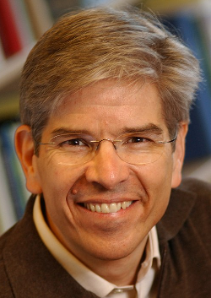
Endogenous Growth Model
Propounded by: Paul Romer in the year 1990.
Build on the limitations of Solow growth models
Included the factor Technology into the model to overcome the shortcomings in the Solow growth model by building macroeconomic models using microeconomic foundations.
Households are assumed to maximize utility subject to budget constraints, while firm maximize profits.
Technology originates from the human capital so no more exogenous– a key factor driving productivity. Therefore, technological advancements increases productivity.
Countries with more skilled labour and invest in R&D grow faster because of better access to human capital. Human capital helps in productivity growth through knowledge sharing.
Example: A pharmaceutical company investing in R&D activities. Once the company invents new formulation, it is a matter of time before that formulation becomes generic.

Slide 9
Endogenous Growth Model
This drives down the economy’s cost of production and the society gains.
Further, Patents helps the innovator/inventor to reap the benefits of new innovation. Patents are generally given for 20 years. Other government policies such as direct R&D subsidies, tax incentives, and low interest rate loans enables firms to invest in R&D, which eventually increases productivity.
Unlike Solow Growth model, the endogenous growth theory explains that countries would experience differential long-run growth rates.
According to Solow growth model, countries can not grow differently because of diminishing return to factor inputs with a constant return to scale-type production function.

